Slide 1
TEAM - 1
NEURAL ADMINS

Slide 2
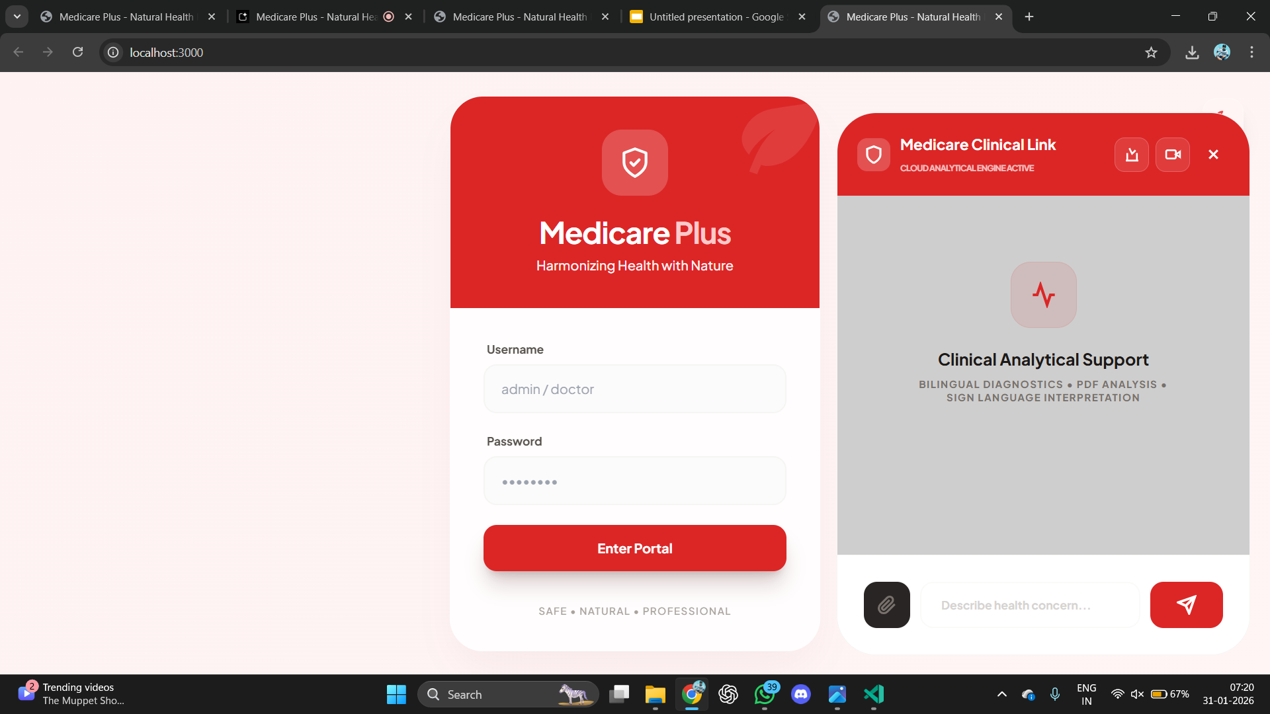
AI CHATBOT

Slide 3
IN CHATBOT YOU CAN ASK YOU DOUBT ABOUT YOUR MEDICAL ISUES IT CAN GIVE FIRST AID , PRECAUTION , AND IT REFER YOU A SPECIALIST DOCTOR NEAR BY YOUR LOCATION . IN IT YOU CAN INSERT YOUR SCAN REPORTS LIVE VIDEO ANALYZING ABOUT YOUR ISUES .

Slide 4
ABOUT OUR WEBSITE
IN THESE GENERATION THERE ARE MANY CHATBOT TO SCAN AND ANALYZE OUR DISEASE .SO,THAT WE PROUDLY MAKE A MULTI USEABLE WEBSITE WHICH HAS THE POWER FULL CHATBOT FOR ANALYZING AND HEALTH ISUES TO GET FULL KNOWLEDGE ADOUT IT GO NEXT SLIDE

Slide 5
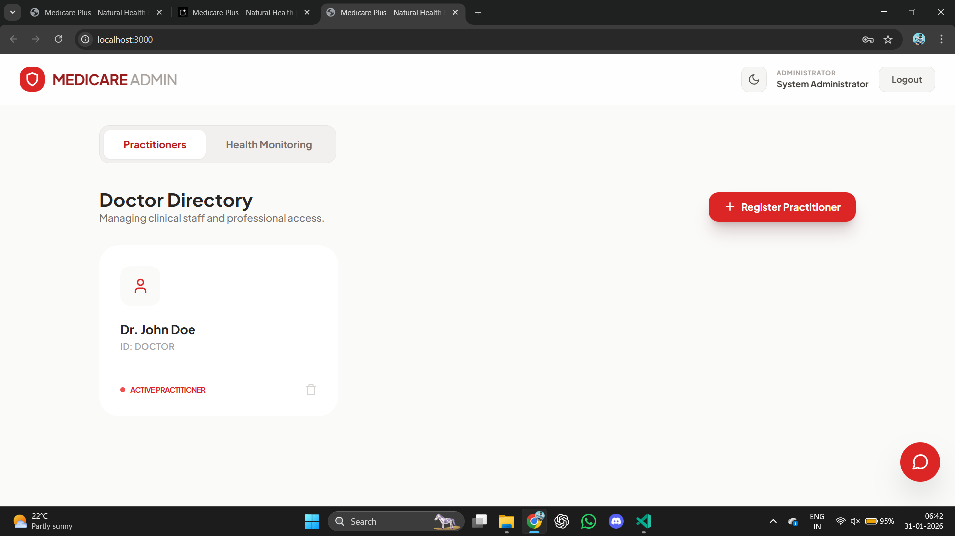
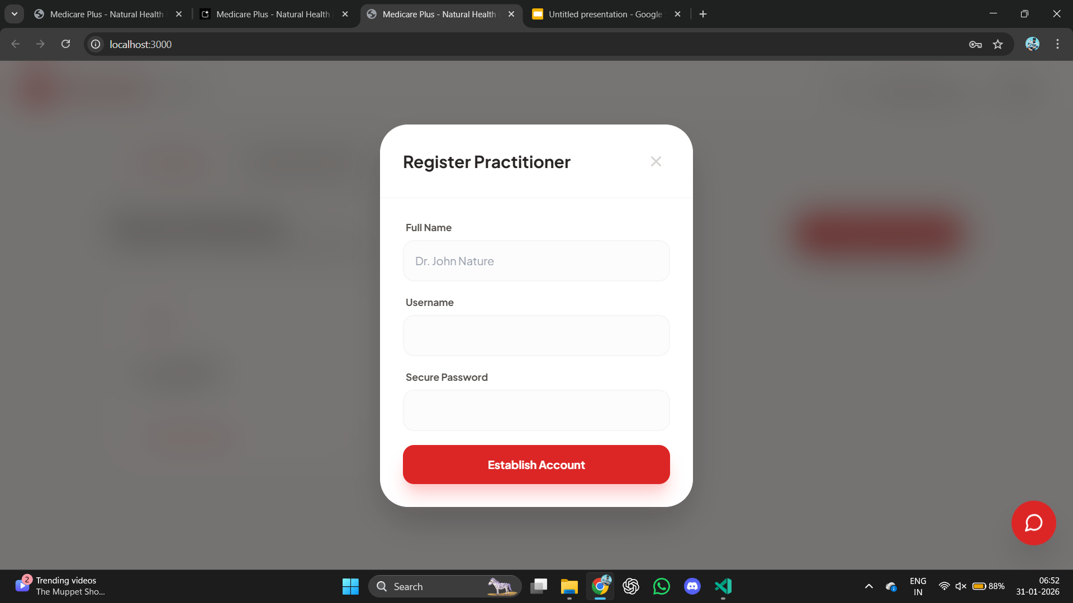
ADMIN PANEL

Slide 6
IN ADMIN PANEL WE CAN HANDLE AND MONITOR ALL DATA

Slide 7
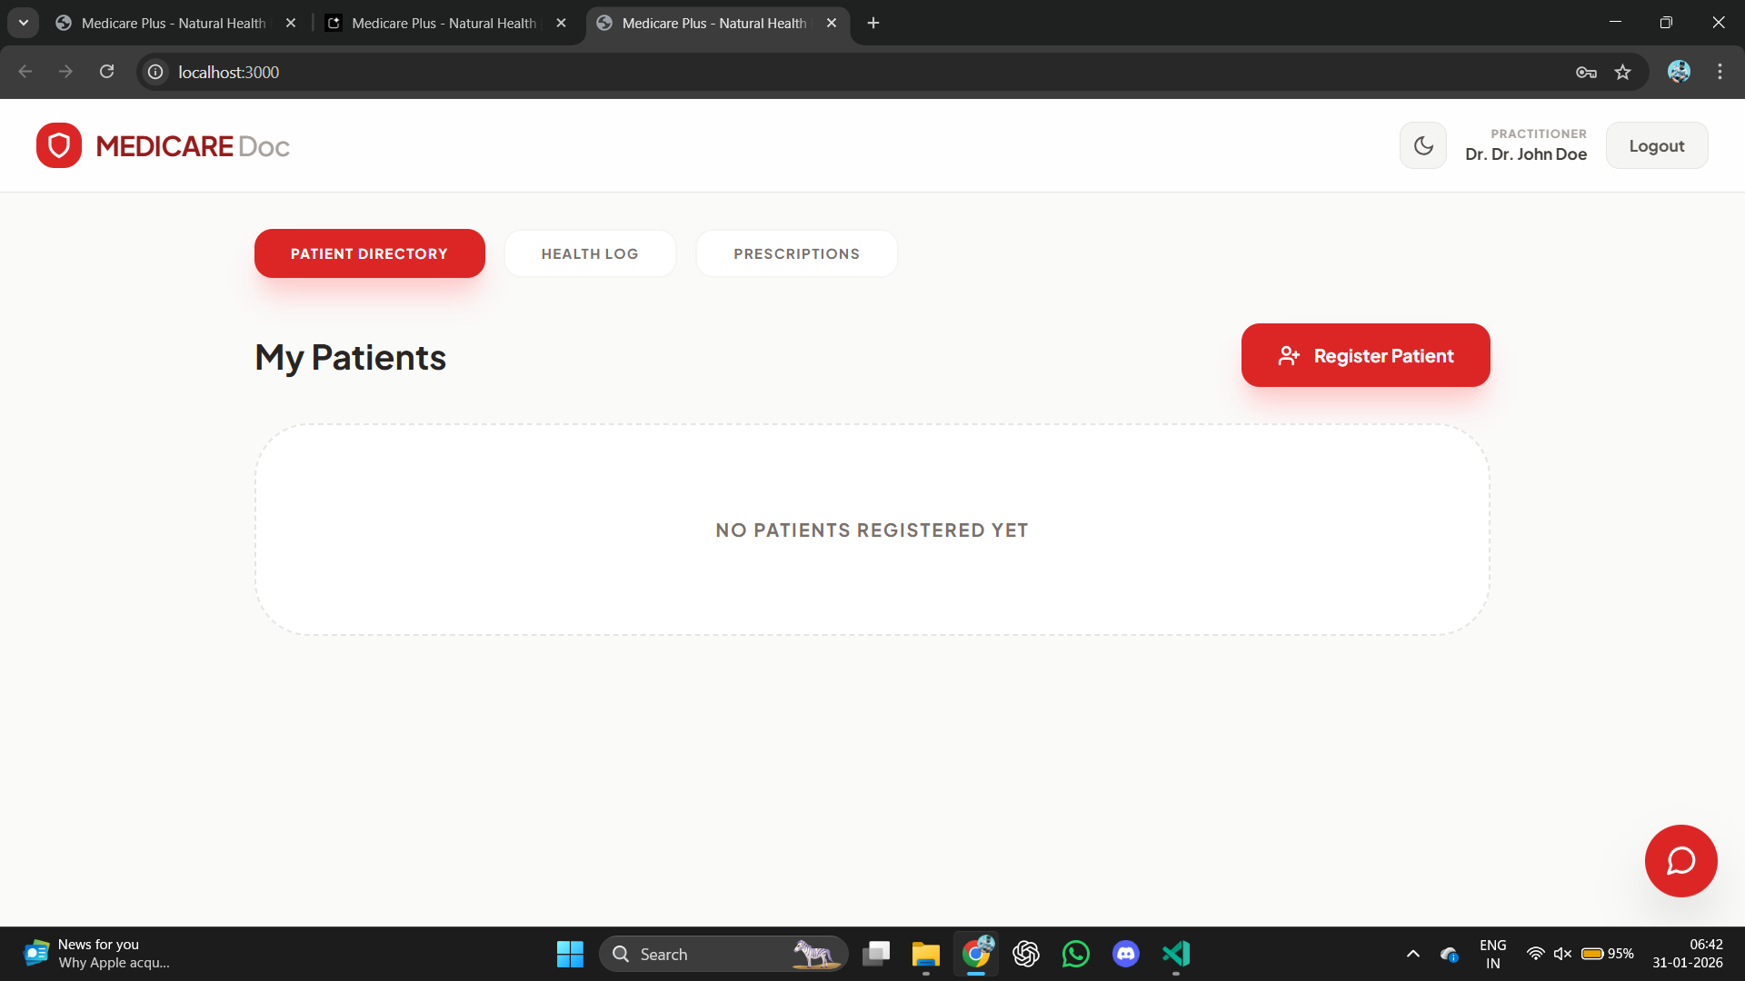
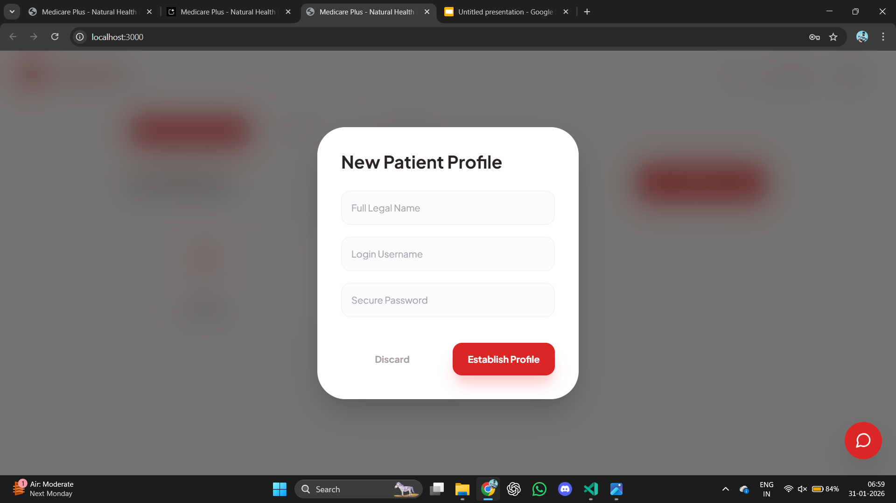
DOCTOR PANEL

Slide 8
IN DOCTOR PANEL WE CAN ADD ACCOUNT FOR PATIENT , ENTRY DATA AND SET PRESCRIPTON FOR PATIENT

Slide 9
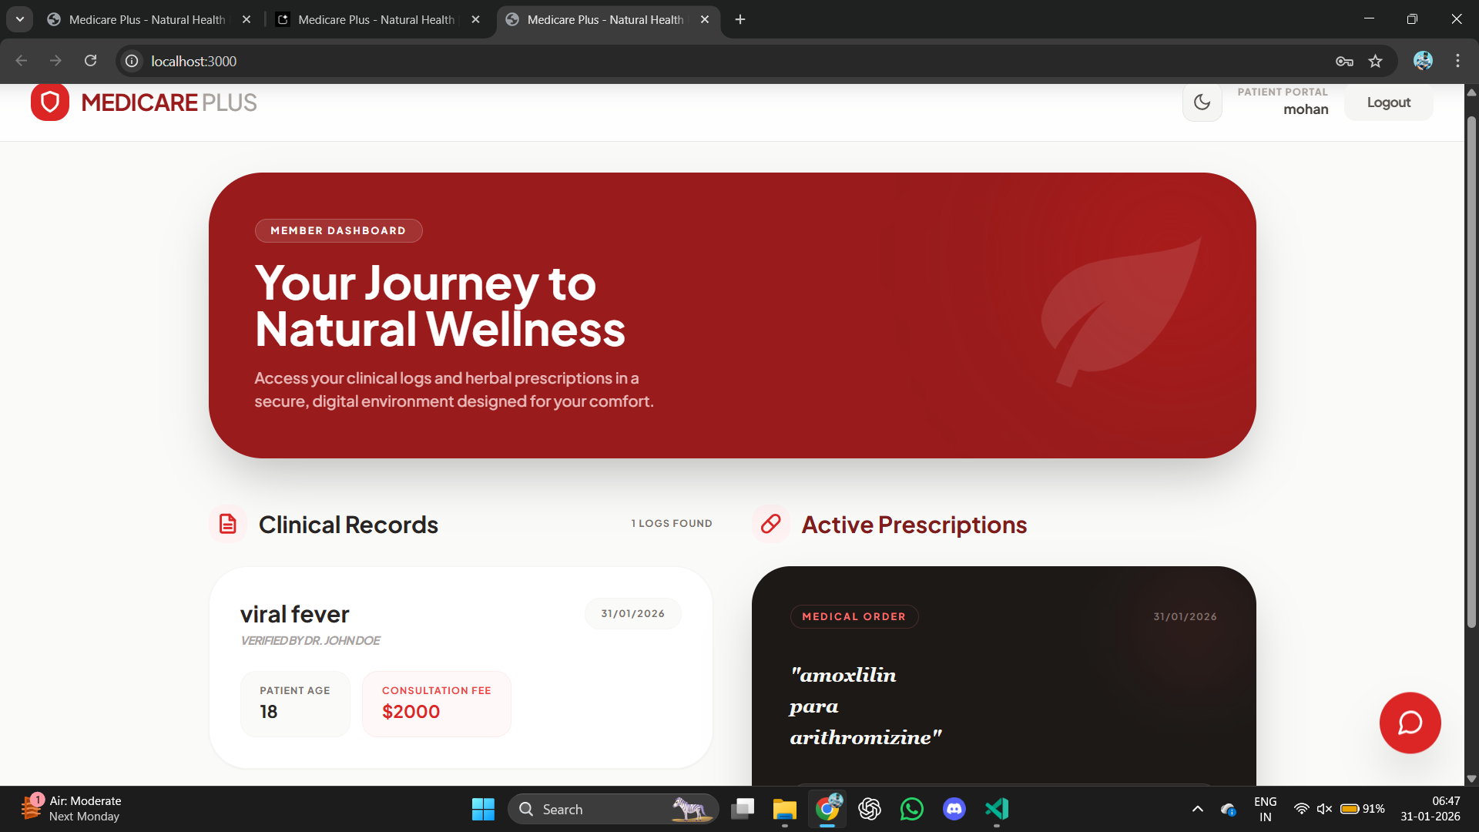
PATIENT PANEL

Slide 10
IN PATIENT PANEL WE CAN SAW OUR DISEASE PRESRIPTION IN IT

